Slide 1
Data gathering
Data exploration
Regression
Data preparation
Joininig
modeling
Conclusions
Clustering
Transform ation

Slide 2
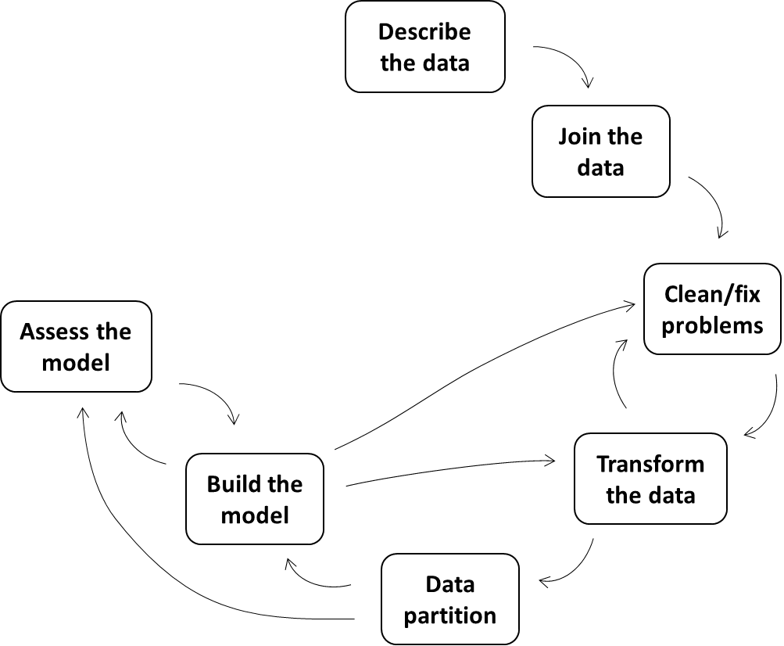
1
2
3
7
4
6
5

